Slide 1
Optimizing Dog Walking Schedule
By: Nora Trapp
GB 730 Final Project

Slide 2
AGENDA
01
PROBLEM
02
EXPLANATION OF MODEL
03
04
IMPLEMENTATION EXPLANATION
SUPPORTING FILES
Why is this model important?
Who would be interested?
What are the decision variables, the objective, and the constraints?
What was used to create this model?
What were key assumptions and challenges?
What is impressive about this model?

Slide 3
01
PROBLEM

Slide 4
IMPORTANCE OF OPTIMIZATION MODEL
Local humane societies often get many volunteers that come in to walk dogs. However, sometimes it’s hard to know which dogs to assign to which volunteer based on how much exercise the dogs need on the spot.
Humane societies could benefit from an easy way to assign volunteers to dogs at any given time of the day to ensure each volunteer can spend quality time with a dog and all dogs are able to escape the shelter for a bit.

Slide 5
02
EXPLANATION OF MODEL

Slide 6
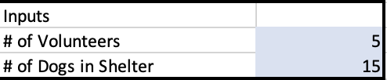
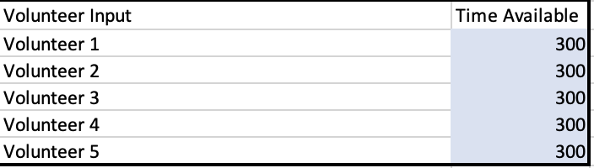
INPUTS OF MODEL
At any moment, the shelter can input the number of volunteers they have available and the number of dogs they want to walk.
The shelter must also input how much time each volunteer is able to walk in minutes.
The shelter must also input how many minutes each dog needs for exercise according to its size.

Slide 7
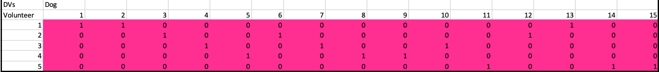

DECISION VARIABLES & OBJECTIVE OF MODEL
There will be a decision variable for each dog/volunteer combination. A 1 means that volunteer will walk that dog and 0 otherwise.
The objective is to minimize the amount of time walked for each volunteer.

Slide 8
CONSTRAINTS OF THE MODEL
01
02
Each dog must be walked
The exercise time required for each dog must be less than the available time of the volunteer
03
04
A volunteer can walk up to three dogs at a time
A volunteer must walk at least one dog

Slide 9
03
IMPLEMENTATION EXPLANATION

Slide 10
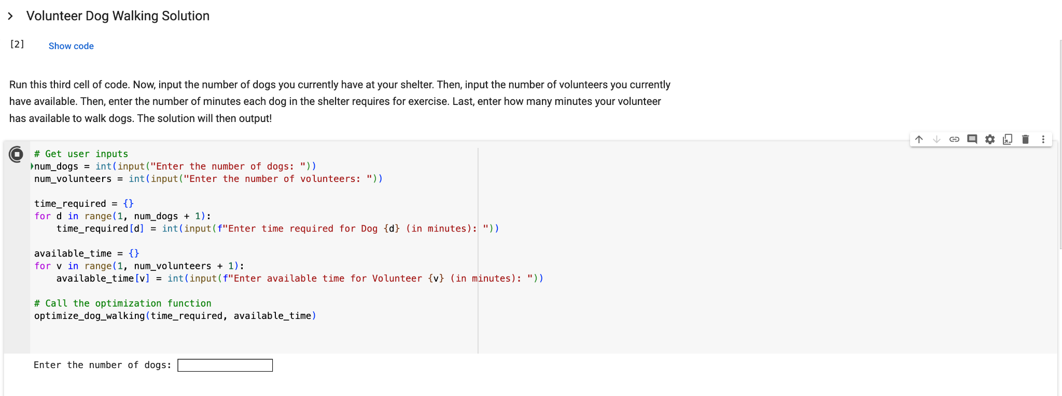
How Shelters Can Use This Model
First, the user of this model must run the first two cells of code (importing pyomo and setting up the model)
Then, they will run the third cell of code. This code lets them type in each of their inputs one at a time.

Slide 11
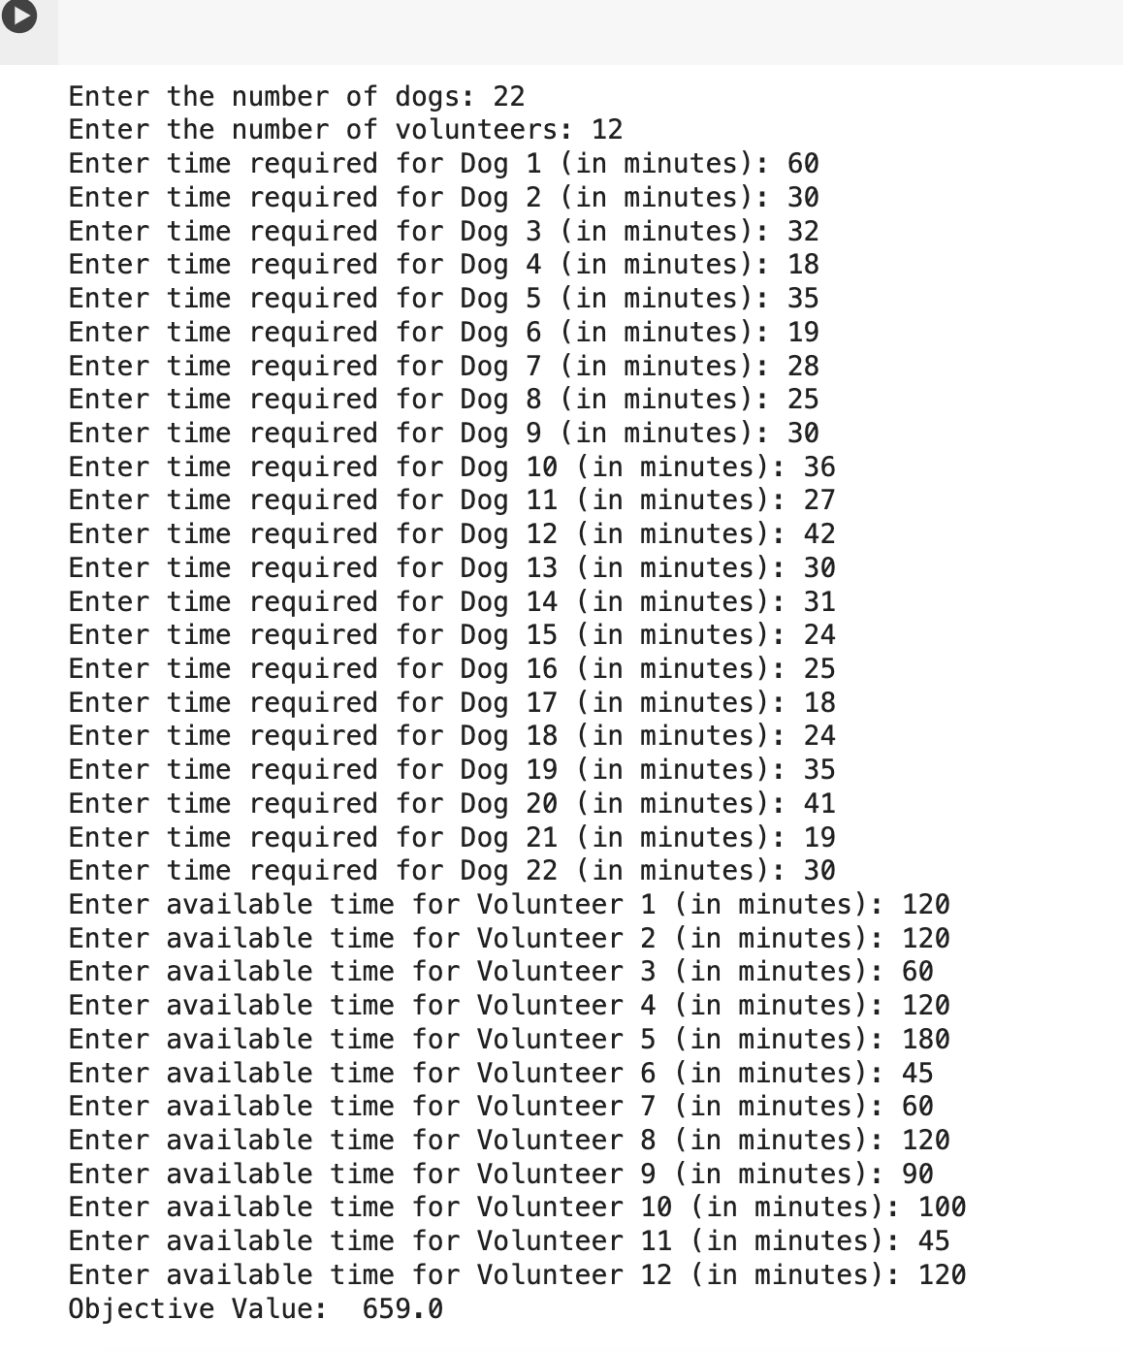
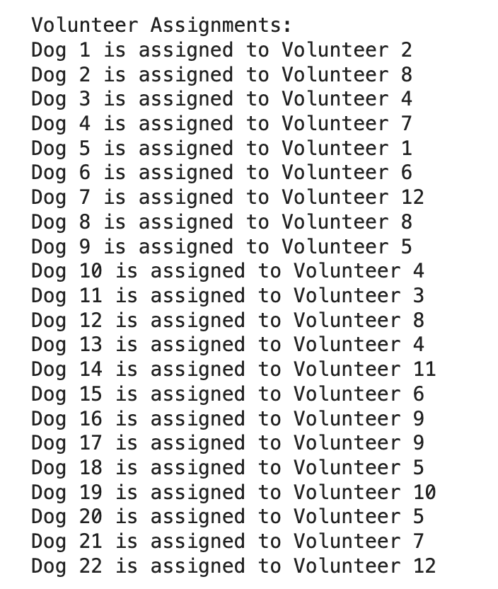
Sample Input:
Sample Solution:

Slide 12
KEY ASSUMPTIONS
CHALLENGES
EXTENSION
Any volunteer is satisfied with walking only one dog or up to three at a time. In reality, a volunteer may not be comfortable handling three dogs at a time.
Any volunteer is okay with walking any of the dogs in the shelter. However, some dogs may require extra patience or attention that only some volunteers are willing to provide.
The time the volunteer is available to walk dogs is accurate. In reality, something may come up that the volunteer has to leave early and not walk the dog for the time it needed.
Designing a model from scratch that would produce a feasible solution (in this model there can be multiple feasible solutions that meet the constraints)
Writing the correct code to run the model in Python
Making the model more user friendly. The shelter now just has to input the necessary information (number of dogs, number of volunteers, time available for each volunteer, and exercise time required for dog) and a solution will appear

Slide 13
Final Thoughts
Benefits:
Model is able to adapt to fluctuations in volunteer count
Model ensures there’s a fair distribution of responsibilities by volunteers and prevents some dogs from being walked more than others
Model provides a more time efficient way to assign volunteers to dogs at any time - doing this by hand could take 1-2 hours, this model can now do it in minutes
Model ensures the dogs required time of exercise is met to help keep the dogs healthy
Limitations:
In the user friendly python model, if the user incorrectly types in an input and presses enter to go to the next input, they must rerun the cell and type the inputs over again
If the time available by volunteers is not enough to cover the exercise time required by the dogs, the model will say error or infeasible solution
Next Steps:
Rather than the solution just being a list, I would make it more aesthetic to look at and easier to read
Some volunteers may have preferences on dogs they want to walk, so I could incorporate that into the model

Slide 14
04
SUPPORTING FILES

Slide 15
Excel File
Single Python Model
User Friendly Python Model
I then used the Excel model to guide me in writing code in Python to solve one instance of the problem
I then transformed the code in Python so that the model can be adapted to each shelter’s needs
I implemented my problem in Excel when creating it to make sure I would get a feasible solution and to better understand how it works

